Slide 2




Muralidharan Deenathayalan
Associate Director – Software Innovation
https://www.quanticate.com
https://twitter.com/muralidharand
https://www.linkedin.com/in/muralidharand/
https://www.codingfreaks.net/

Slide 3
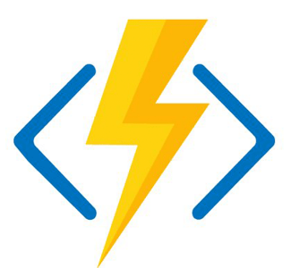
Zero to Hero on Azure Functions Security
Muralidharan Deenathayalan

Slide 4

What you will learn…
Security Basics
Important Keywords
Note about of Azure Functions Authorization Levels
Different ways of Protecting Azure Functions
Demo - Protecting Azure Functions using Azure AD
Demo - Protecting Azure Functions using API Management
Security recommendation for Azure Functions
Q & A

Slide 5

Prerequisites
Active Azure Subscription
Postman
Visual Studio 2022

Slide 6



Security Basics
Authentication verifies the identity of a user or resource.
Authorization determines the user access rights.

Slide 7
Important Keywords
OAuth 2.0
JWT – JSON Web Token
Azure AD
Tenant Id
Client Id
Client Secret
Manifest File
Managed Identity
CORS
Azure Key Vault
Authorization Code
Implicit Flow
Client Certificate
OIDC

Slide 8
Azure Function – Authorization Levels
Anonymous – No API key is required.
Function – Default. Function specific API key is required.
System – They can access all the Functions within the host.
Admin – Master key and admin API key is required.
User – Based on User token.

Slide 9








Different ways of Protecting Azure Functions
Identity Providers
API Management
Network / IP Restrictions
Managed Identities
Client Certificates
Defender for Cloud
Log Analytics

Slide 10
Protecting Azure Functions – Identity Providers
Microsoft Identity Platform – Azure Active Directory
Facebook
Google
Twitter
GitHub
OpenID Connect

Slide 11
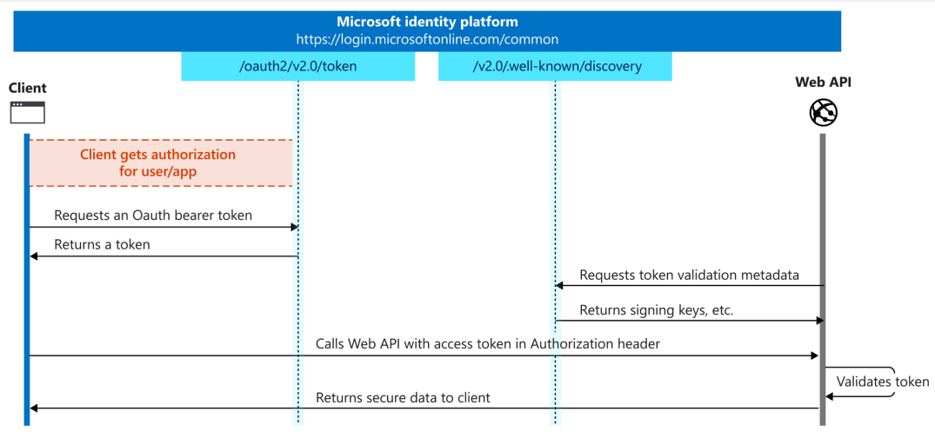
Protecting Azure Functions – Identity Providers

Slide 12

Protecting Azure Functions – API Management
Authentication Options
Basic Authentication
Subscription Key
Client Certificate
Access Restrictions Policies
Rate Limit
Quota Limit
JWT Validation
Use Web Application Firewall via Azure Application Gateway.
Revisions and Versions in APIM helps to control and govern API endpoints.

Slide 13
Protecting Azure Functions – Network Restrictions
Redirect to HTTPS.
Restrict CORS Access.
Restrict Azure Functions access based on IP.
Use Azure Virtual Network.

Slide 14

Protecting Azure Functions – Managed Identities
Developers need to maintain Client Id, Keys & Secrets etc.
Developer can use Azure Key Vault but Apps / Services defined a way to access Key Vault.

Slide 15
Protecting Azure Functions – Managed Identities
Advantages of Managed Identities
No need to manage credentials and credentials are not accessible.
Can be used to authenticate to any resource that supports Azure AD authentication.
No additional costs required.
Types of Managed Identities
System assigned
User assigned

Slide 16
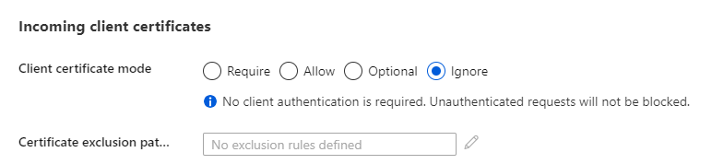
Protecting Azure Functions – Client Certificates
Phishing-resistant, easy to use, and convenient compared with username & passwords.
X-ARR-ClientCert key is used to send the certificate information.
Can be used for Self-signed certificates, not for chained certificates.
By default, Client certificate option is set to Ignore.

Slide 17
Protecting Azure Functions – Defender for Cloud
To identify attacks targeting applications running over App Service.
Generates security recommendations based on its findings. Ex : Configuration
Detects a multitude of threats to your App Service resources by monitoring. Ex: DDoS

Slide 18


Protecting Azure Functions – Log Analytics
Application Insights
Azure Monitor
Azure Sentinel

Slide 19

Protecting Azure Functions – Using Azure AD Demo

Slide 20

Protecting Azure Functions – Using Azure AD Demo
Authentication
Configure Identity Provider
Configure AAD
Generate JWT
Validate JWT – using https://jwt.ms
Accessing Protected Function app
Using Postman
Using Azure Portal
Using Visual Studio

Slide 21


Protecting Azure Functions – API Management Demo

Slide 22


Protecting Azure Functions – API Management Demo
Remove Asp.net Headers
X-Powered-By
X-AspNet-Version
Throttling income requests
Rate Limit Policy
Allow / deny requests based on IP Address
Authentication
Using Subscription Key
Configure AAD
Validate JWT

Slide 23
Protecting Azure Functions – Few More Configs
Network Restrictions
Allow / deny requests based on IP Address
Platform Configurations
Turning on FTPS
Disabling HTTP
Remote Debugging
Client Certificates
Managed Identities
System Assigned
User Assigned

Slide 24
Security recommendation for Azure Functions
Use HTTPS
Validate Inputs effectively.
Authorize users based on Function level authorizations.
CORS should not allow all domains to access your API app.
Don’t send the tokens in URL.
Limit permissions and use Azure RBAC.
Use Managed Identities and Key Vault.
Enable Client Certificate options and use client certificate
Disable remote debugging.
Disable FTP and use FTPS
Turn on the required features via configurations.

Slide 25
Take Away
Now you will be aware of,
Enabling Authentication on Azure Functions.
Configuring Identity Provider for Azure Functions.
Azure App registrations and configurations.
Exposing Azure Functions via API Management.
Configuring Identity Provider for Azure Functions in APIM.
Creating Inbound and Outbound policies for Azure Functions using APIM.
Security recommendation for Azure Functions.

Slide 26
Q & A

Slide 27






Platinum Partner
Gold Partner
Silver Partner

Slide 28
Thank You !
Zero to Hero on Azure Functions Security
Muralidharan Deenathayalan
https://twitter.com/muralidharand
https://www.linkedin.com/in/muralidharand/
https://www.codingfreaks.net/

